Slide 1


Name – 1) Devashish Mishra (2101641550035)
2) Aman Nigam (2101641550015)
3) Pragati singh (2101641550055)

Slide 2
About -
Pet health tracking bands can be an innovative and valuable endeavor. Such a project aims to develop wearable devices specifically designed for pets to monitor their health and well-being.
This tracking bands can provide real-time data on various vital signs and behaviors, allowing owners, veterinarians, and researchers to closely monitor and manage animal health.
At least 15,000 cattle have been infected with the lumpy skin disease virus and 115 cattle deaths have been reported in Uttar Pradesh so far. As many as 1,414 villages in UP are under the grip of the virus.

Slide 3
USES -
Every owner must have the record of their pets health it can help in the tracking of its health .
Regular tracking can make less chances of sickness of their pets.
Or if they are infected by any disease than it also helps in its tracking as well as to make sure that those are not coming in the contact of non infected one’s that can cause the spread of disease .
I think its our responsibility to make a check on our pets health because they also play an important role in our life .

Slide 4
The device also contains the Alert button if any how your pet is lost and anyone push that button then the location of your pet is send to owner’s telegram or what’s app account
Integrate additional sensors, such as GPS or accelerometers, to track an animal's location, movement patterns, and behavior. This information can help monitor activity levels, identify potential injuries or distress, and prevent accidents or escapes.

Slide 5
Components used -
1) ESP-32(DEVKIT V1) 2) Neo 6M GPS module 3) DHT 11 Temperature & Humidity 4) Max30100 Heart-rate &sp02 5) SSD1306 OLED display (128x64) 6) Adafruit IO (MQTT Server)
7) Push Button (telegram alert )

Slide 6
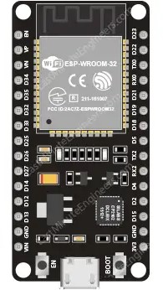
Components Specifications -
ESP-32 (DEVKIT V1):
Microcontroller: Tensilica Xtensa LX6 dual-core processor
Wi-Fi: 802.11 b/g/n
Bluetooth: v4.2 BR/EDR and BLE
Flash: 4 MB
RAM: 520 KB

Slide 7
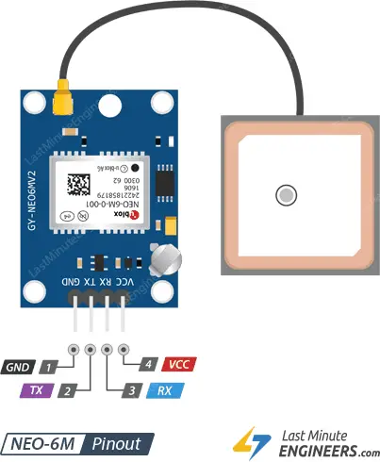
Neo 6M GPS Module:
Receiver Type: 22 tracking / 66 acquisition channels
C/A code, 1.023MHz chip rate
Sensitivity: -161 dBm tracking, -147 dBm acquisition
Update Rate: 1Hz
Accuracy: approx. 2.5 meters
.

Slide 8
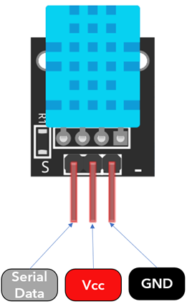
DHT11 Temperature & Humidity Sensor:
Temperature Range: 0 to 50°C
Humidity Range: 20% to 90%
Accuracy: ±2°C, ±5%
Response Time: 1-2 seconds
Operating Voltage: 3.5V to 5.5V
.

Slide 9
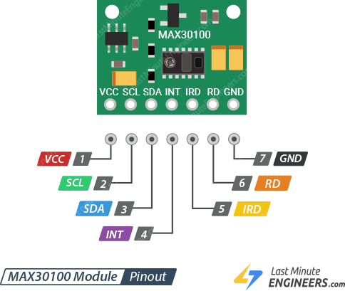
Max30100 Heart-rate & SpO2 Sensor:
LED Wavelengths: Red: 660nm, Infrared: 880nm
Sampling Rate: Adjustable (up to 3200 samples per second)
Heart Rate Range: 30 bpm to 220 bpm
SpO2 Range: 0% to 100%
Operating Voltage: 1.8V to 3.3V
.

Slide 10
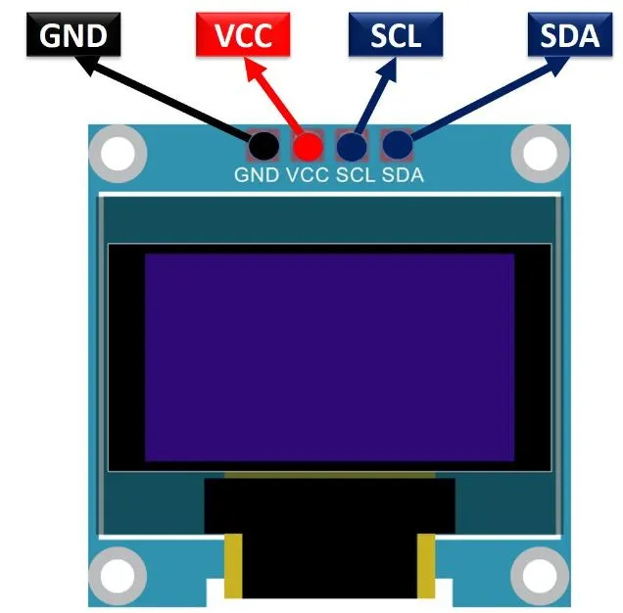
SSD1306 OLED Display (128x64):
Resolution: 128x64 pixels
Diagonal Size: 0.96 inches
Display Technology: OLED (Organic Light Emitting Diode)
Communication: I2C (or SPI)
Operating Voltage: 3.3V (typically)
.

Slide 11

MaxAdafruit IO (MQTT Server):
Adafruit IO is a cloud-based IoT platform.
Supports MQTT (Message Queuing Telemetry Transport) for communication.
Provides easy integration with various IoT devices.
Features data visualization, storage, and control capabilities.
Allows you to create dashboards for monitoring and controlling connected devices.

Slide 12
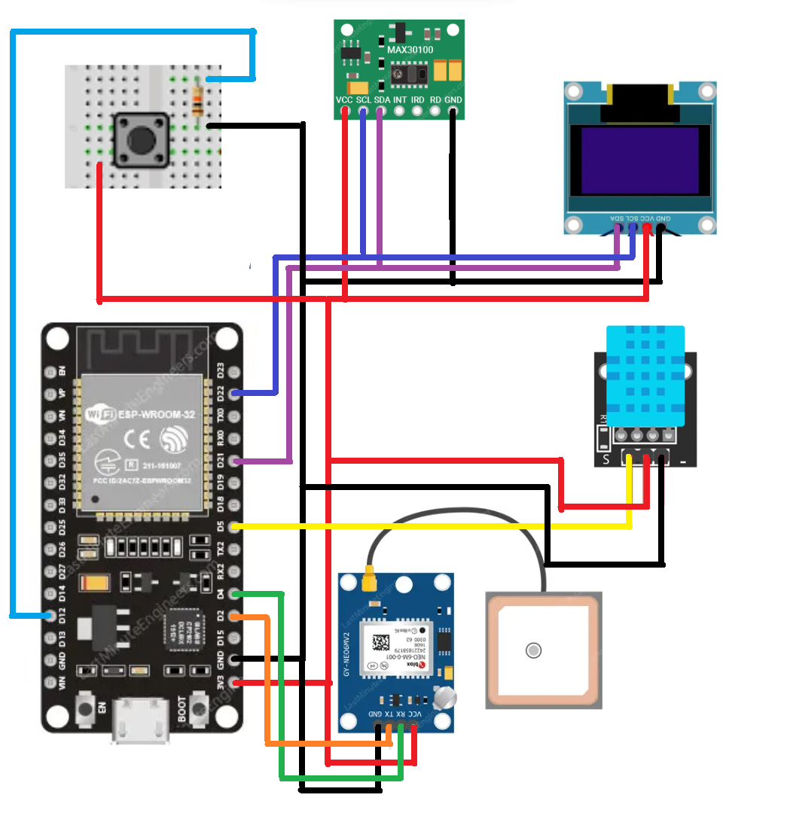
Circuit Diagram -
MAX30100
Push button
OLED
DHT11
ESP 32
NEO 6M GPS

Slide 13
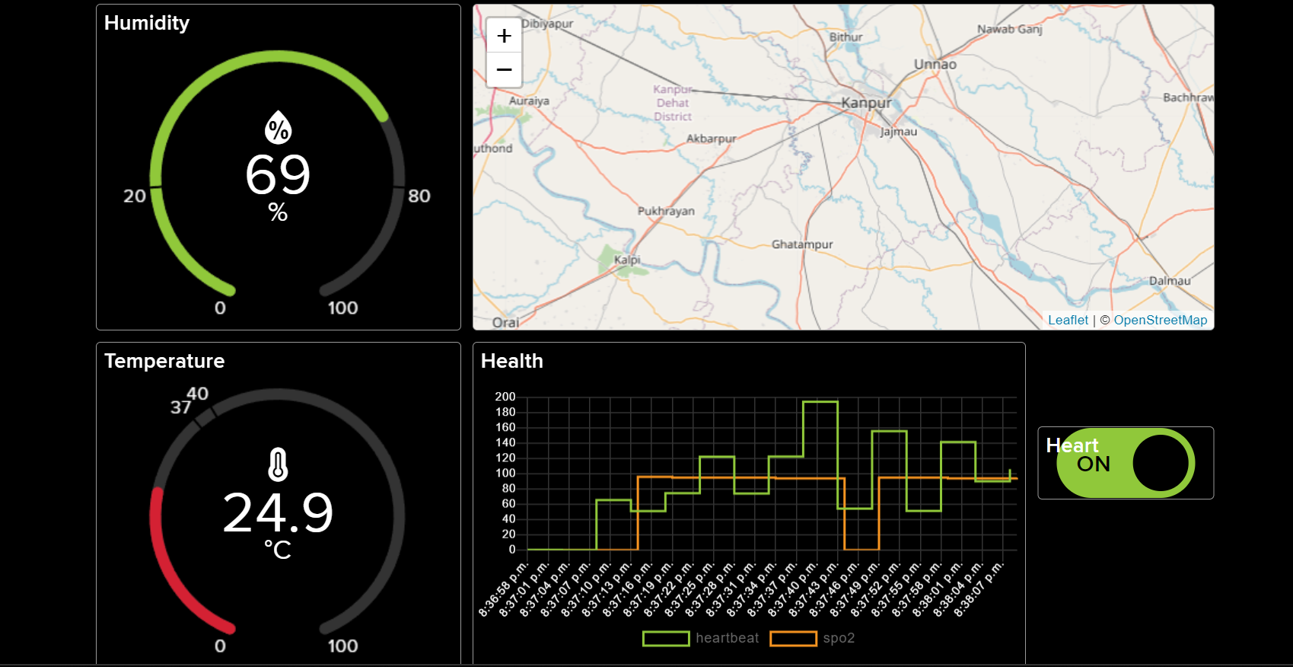
Monitoring Window -
The measured data will be shown on adafruit server .

Slide 14
Challenges :-
Power Consumption: The continuous operation of sensors and communication modules can lead to high power consumption. Battery life may be limited, and you may need to implement power-saving techniques to extend the device's runtime.
Accuracy of Health Measurements: The accuracy of health measurements, especially from sensors like the MAX30100 pulse oximeter, can be affected by various factors, including sensor placement, environmental conditions, and individual variability. Calibrating and validating sensor data may be necessary for accurate health monitoring.
Limited Sensor Support: The project uses specific sensors (DHT, MAX30100, GPS), and adding or replacing sensors may require modifications to the code. Consider sensor compatibility and expandability for future enhancements.

Slide 15
Future Upgrades :
Improved Sensors : Upgrade or add more advanced sensors for better accuracy and additional health monitoring parameters. For example, consider sensors for respiratory rate, body temperature, or more advanced ECG monitoring.
Wireless Charging : Implement wireless charging capabilities to improve the convenience of recharging the device. This can be especially useful for devices intended for continuous use.
Collaboration with Veterinary Professionals : Collaborate with veterinary professionals to incorporate features that cater to specific pet health monitoring needs. This could involve consulting veterinarians for valuable insights and recommendations.

Slide 16
References -
https://lastminuteengineers.com/getting-started-with-esp32/
https://lastminuteengineers.com/esp32-dht11-dht22-web-server-tutorial/
https://lastminuteengineers.com/max30100-pulse-oximeter-heart-rate-sensor-arduino-tutorial/
https://lastminuteengineers.com/neo6m-gps-arduino-tutorial/
https://lastminuteengineers.com/oled-display-esp32-tutorial/
https://learn.adafruit.com/welcome-to-adafruit-io/getting-started-with-adafruit-io
https://learn.adafruit.com/adafruit-io-basics-dashboards/overview
https://cdn-learn.adafruit.com/downloads/pdf/adafruit-io-basics-gps.pdf

